Slide 1

Daft.ie
Bruna Abellaneda
30/03/2022

Slide 2
Outline?
Competitors
Why Daft​
Structure​
Stack/Frameworks
Challenges​
Future work​
Cloud​
Questions

Slide 3
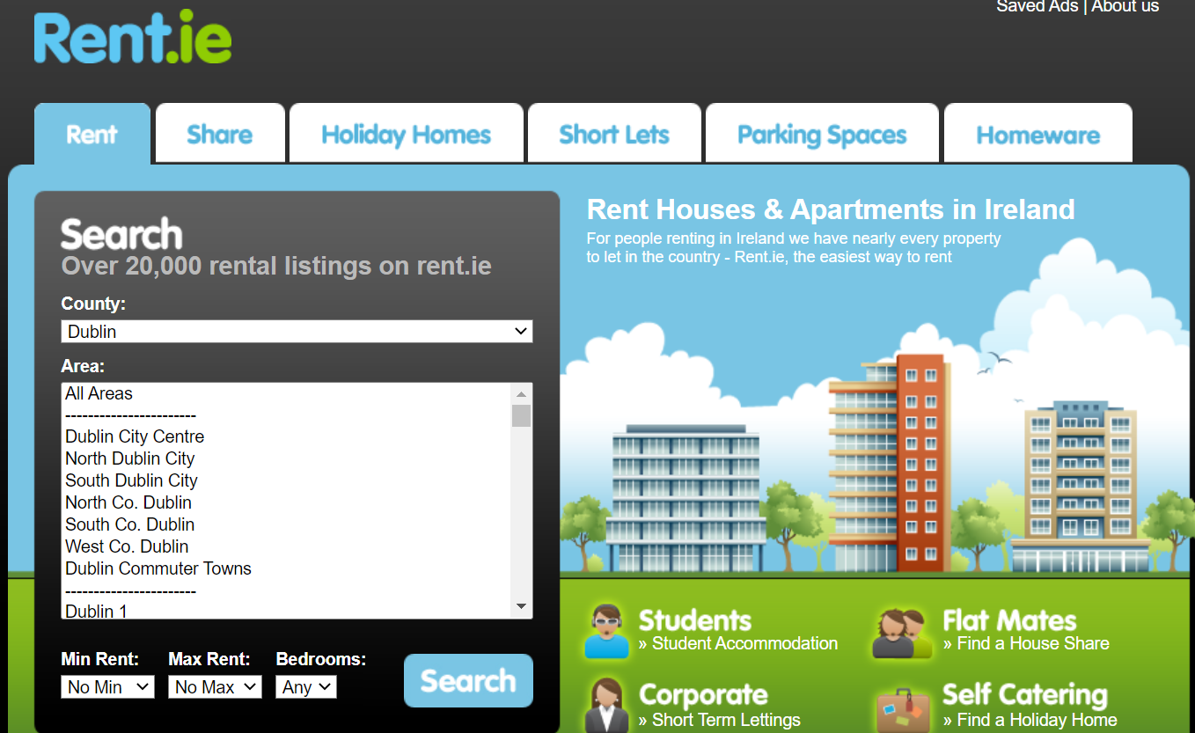
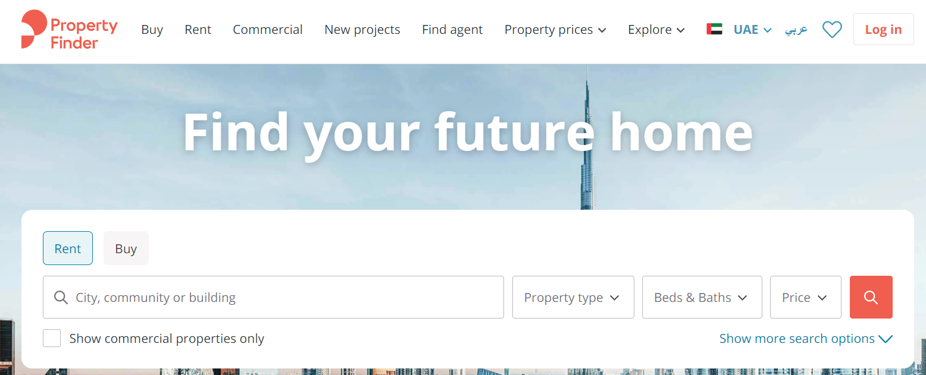
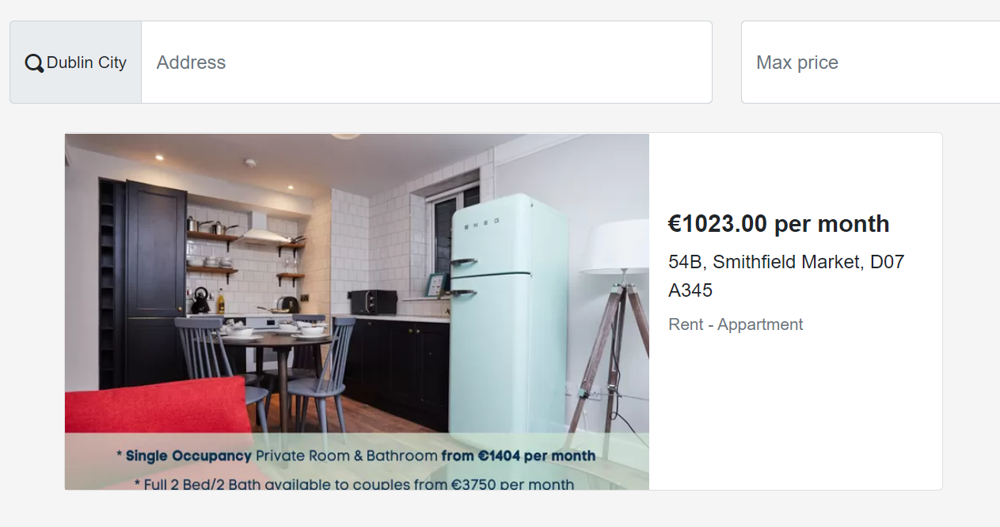

Competitors
​​
Rent.ie, Qwertee, Citylets, Propertyfinder

Slide 4

Why Daft​
Daft is one of the most popular websites in Ireland and worldwide. It’s usability and simplicity is key to customers and for me it is the key aspect of the website.​

Slide 5
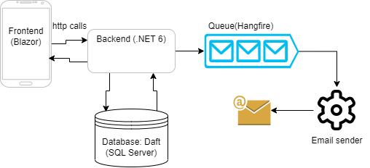
Structure
​

Slide 6
Stack/ Framework
Blazor is a brand new framework for web-development from Microsoft and has huge potential to grow and its also very performative. It can compile to web-assembly (native) and be hosted as server side, web-assembly or hybrid.
This also means there’s no need to use javascript on the frontend and code can be also shared between front and backend.

Slide 7
Challenges​
Developing with SOLID and DDD principles in mind can be challenging, because sometimes you might sacrifice some time refactoring to gain a little bit of readability.
Working with a new framework can be harsh sometimes because you cant easily find the solution for some questions you might have while developing the application
Splitting up your project in smaller parts can be also tricky while deploying the application to the cloud, since you’ll also have to deploy each one of them separately

Slide 8
Future work
Initial design/creation
of the project
Apply captcha before creating requests
Develop request policy to avoid attacks
Launch
2022
Jan
Feb
Mar
Apr
May
Jun
Jul
Aug
Sep
Oct
Nov
Dec
Finished deploy to cloud
Finished deploy to cloud
Create unit/integration tests & integrate to Azure CI/CD pipeline

Slide 9
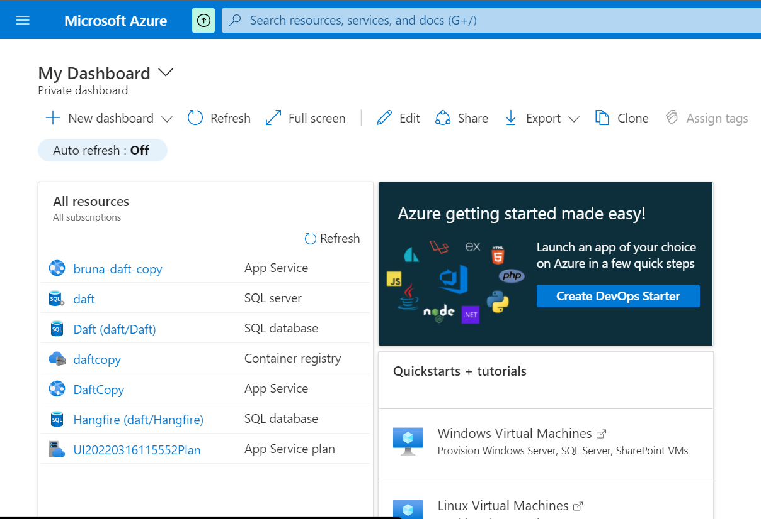
Cloud​
I used Azure as the hosting server since it’s all easy integrated to Microsoft/Visual Studio and they also provide some credit for testing purposes.

Slide 10

Call to action
Contoso is the best technology platform on the market​
Download Contoso to try it out and provide feedback​
​

Slide 11


Thank you
Mirjam Nilsson​​
206-555-0146​
mirjam@contoso.com​
www.contoso.com​

Slide 12

Any questions?

